Slide 1
Multiple Classification
David Carlson

Slide 2
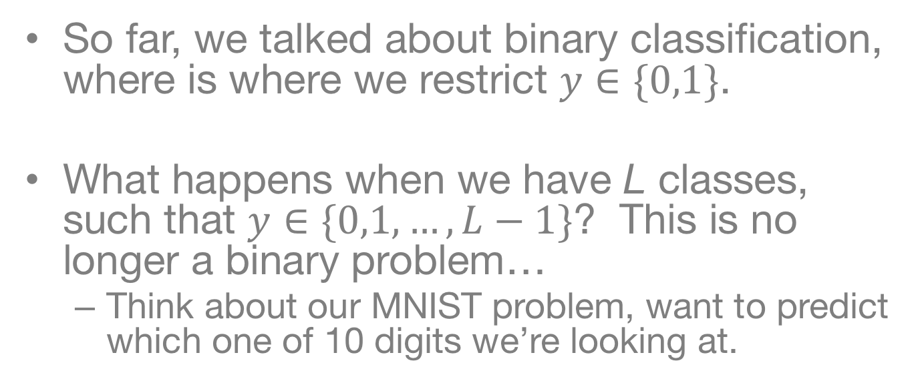
Multi-Class Classification
So far, we talked about binary classification, where is where we restrict $y∈\{0,1\}$.
What happens when we have L classes, such that $y∈\{0,1,…, L−1\}$? This is no longer a binary problem…
Think about our MNIST problem, want to predict which one of 10 digits we’re looking at.

Slide 3
Quick Overview
So far we have talked about:
Regression Problems
Binary Classification Problems
We want to figure out how to predict one of many possible outcomes
Learn many binary classifiers, and convert to multiple classes
Predict multiple classes by slightly modifying our previous methods

Slide 4
Softmax Regression

Slide 5
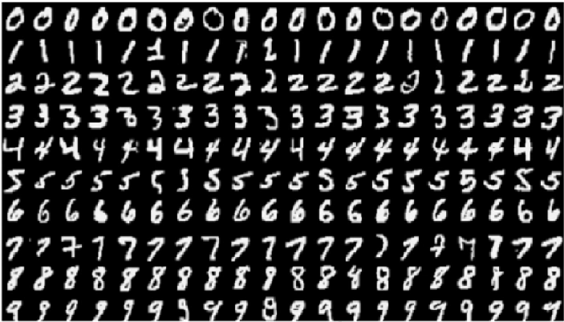
The MNIST Dataset
The Modified National Institute of Standards and Technology (MNIST) contains pictures of handwritten digits (0,1,2,…)
Want to be able to tell what digit each image is (e.g. optical character recognition)

Slide 6








Learning on MNIST
$${σ(z}_{i})$$
$$z_{i}=(b_{1}×x_{i1})+{\left(b_{2}×x_{i2}\right)+⋯+\left(b_{M}×x_{iM}\right)}_{}$$
$$z_{i}$$
Vectorization
$$b_{1}$$
$$b_{M}$$
$$x_{i1}$$
$$x_{iM}$$
Logistic Regression Model (or “Network”)
Learned Parameters
$({b_{0},b}_{1},…b_{N})$

Slide 7






Logistic Regression
Convert to Probability
$${σ(z}_{i})$$
$$z_{i}$$
Linear Model
$$b_{1}$$
$$b_{M}$$
$$x_{i1}$$
$$x_{iM}$$

Slide 8
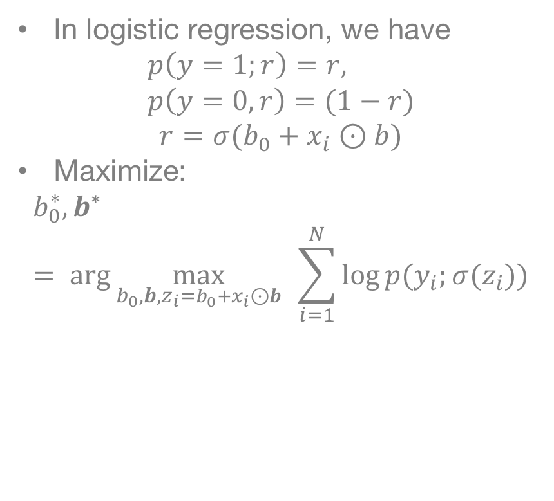
Refresher on Model Fitting
In logistic regression, we have
$$p\left(y=1;r\right)=r, \\ p\left(y=0,r\right)=(1−r)$$
$$r=σ(b_{0}+x_{i}⊙b)$$
Maximize:
$$b_{0}^{∗},b^{∗}= \arg{\max_{b_{0},b, z_{i}=b_{0}+x_{i}⊙b}{ }\sum_{i=1}^{N}{\log{p({y_{i};σ(z}_{i}))}}}$$
$${σ(z}_{i})$$
$$z_{i}$$
$$b_{1}$$
$$b_{M}$$
$$x_{i1}$$
$$x_{iM}$$

Slide 9
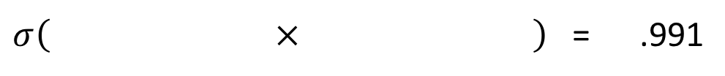
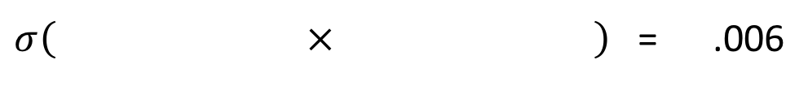
Learned Weights for 0/1
We think that this is a “zero” (.6% chance it is a “one”)
$σ\left( × \right)$ = .006
We think that this is a “one” (99.1% chance it is a “one”)
$σ\left( × \right)$ = .991

Slide 10
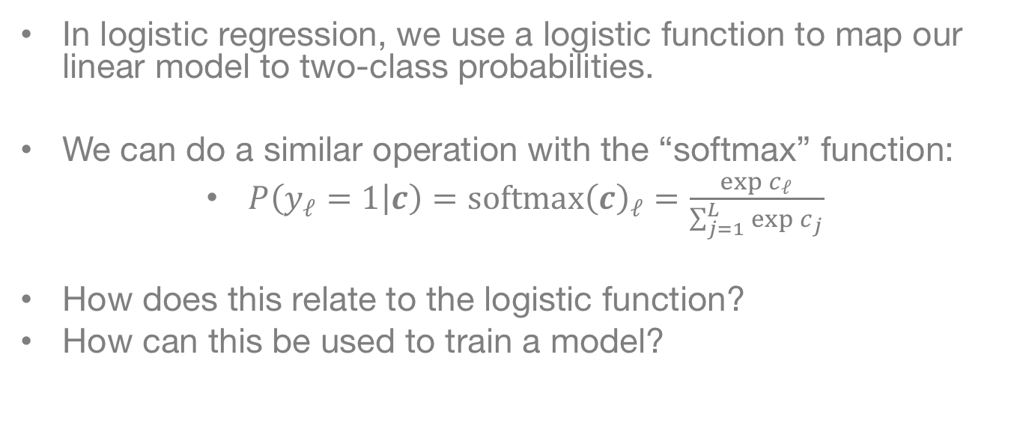
“Softmax” Mapping
In logistic regression, we use a logistic function to map our linear model to two-class probabilities.
We can do a similar operation with the “softmax” function:
$P\left(y_{ℓ}=1 | c\right)=softmax{\left(c\right)}_{ℓ}=\frac{\exp{c_{ℓ}}}{\sum_{j=1}^{L}{\exp{c_{j}}}}$
How does this relate to the logistic function?
How can this be used to train a model?

Slide 11

Softmax Regression
Convert to Probability
…
$${softmax(z}_{i})$$
$$z_{i}$$
Linear Model
$$b_{1}$$
$$b_{M}$$
$$x_{i1}$$
$$x_{iM}$$

Slide 12
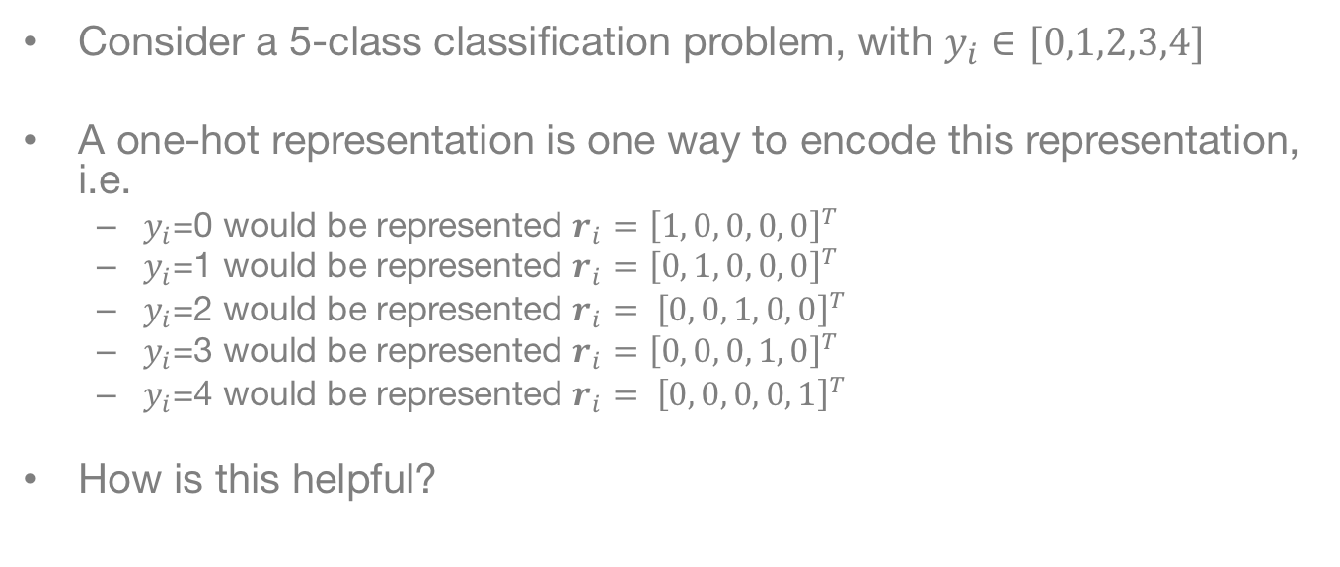
One-Hot Representation
Consider a 5-class classification problem, with $y_{i}∈[0,1,2,3,4]$
A one-hot representation is one way to encode this representation, i.e.
$y_{i}$=0 would be represented $r_{i}={\left[1, 0, 0, 0, 0\right]}^{T}$
$y_{i}$=1 would be represented ${r_{i}=\left[0, 1, 0, 0, 0\right]}^{T}$
$y_{i}$=2 would be represented $r_{i}= {\left[0, 0, 1, 0, 0\right]}^{T}$
$y_{i}$=3 would be represented ${r_{i}=\left[0, 0, 0, 1, 0\right]}^{T}$
$y_{i}$=4 would be represented $r_{i}= {\left[0, 0, 0, 0, 1\right]}^{T}$
How is this helpful?

Slide 13
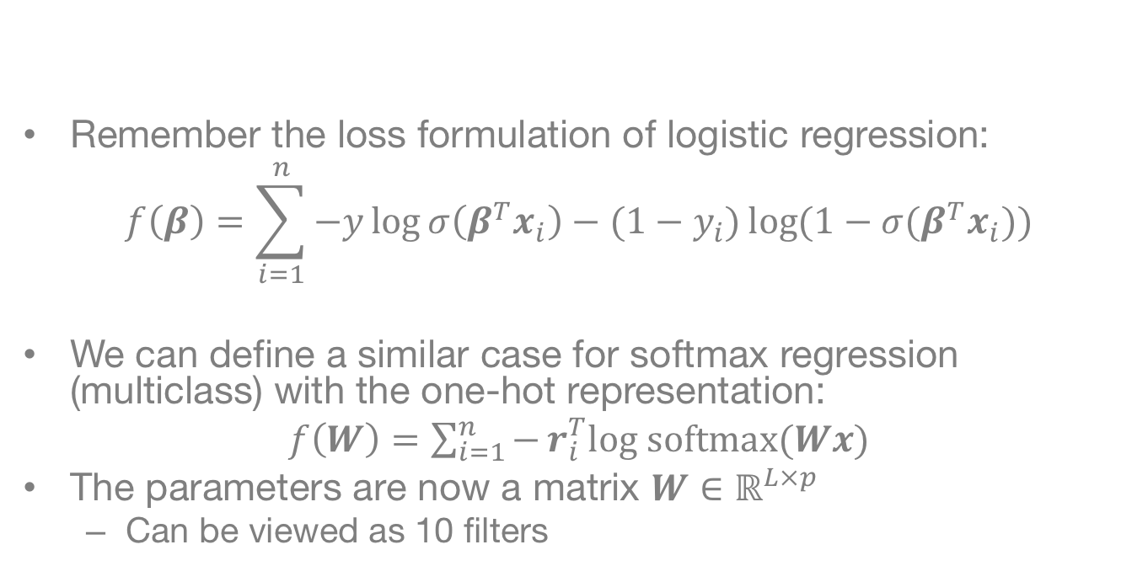
Softmax Regression
Remember the loss formulation of logistic regression:
$$f\left(β\right)=\sum_{i=1}^{n}{−y\log{σ\left(β^{T}x_{i}\right)}−(1−y_{i})\log{(1−σ(β^{T}x_{i})}})$$
We can define a similar case for softmax regression (multiclass) with the one-hot representation:
$f\left(W\right)=$ $\sum_{i=1}^{n}{−}r_{i}^{T}log softmax(Wx)$
The parameters are now a matrix $W∈ℝ^{L×p}$
Can be viewed as 10 filters

Slide 14
Filter Visualization
Filters are now much more complex, harder to make sense of…

Slide 15
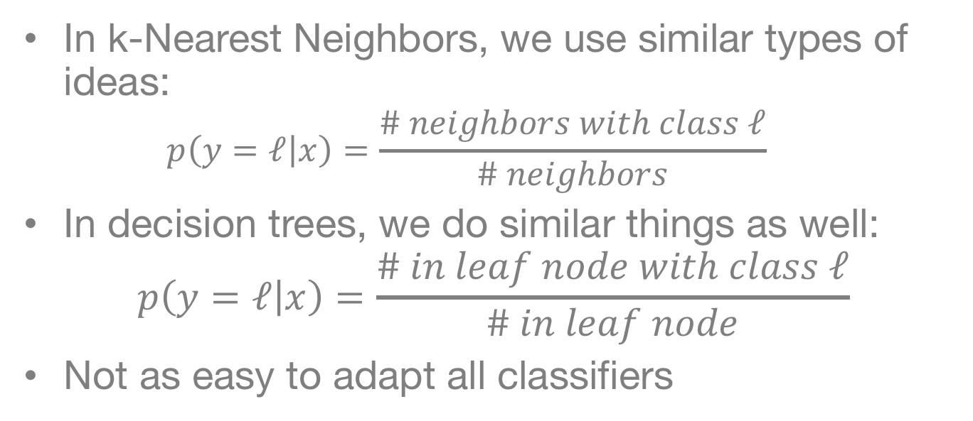
Similar Ideas for kNN and Trees
In k-Nearest Neighbors, we use similar types of ideas:
$$p\left(y=ℓ | x\right)=\frac{\# neighbors with class ℓ}{\# neighbors}$$
In decision trees, we do similar things as well:
$$p\left(y=ℓ | x\right)=\frac{\# in leaf node with class ℓ}{\# in leaf node}$$
Not as easy to adapt all classifiers

Slide 16
Learning Multiple Binary Classifiers

Slide 17
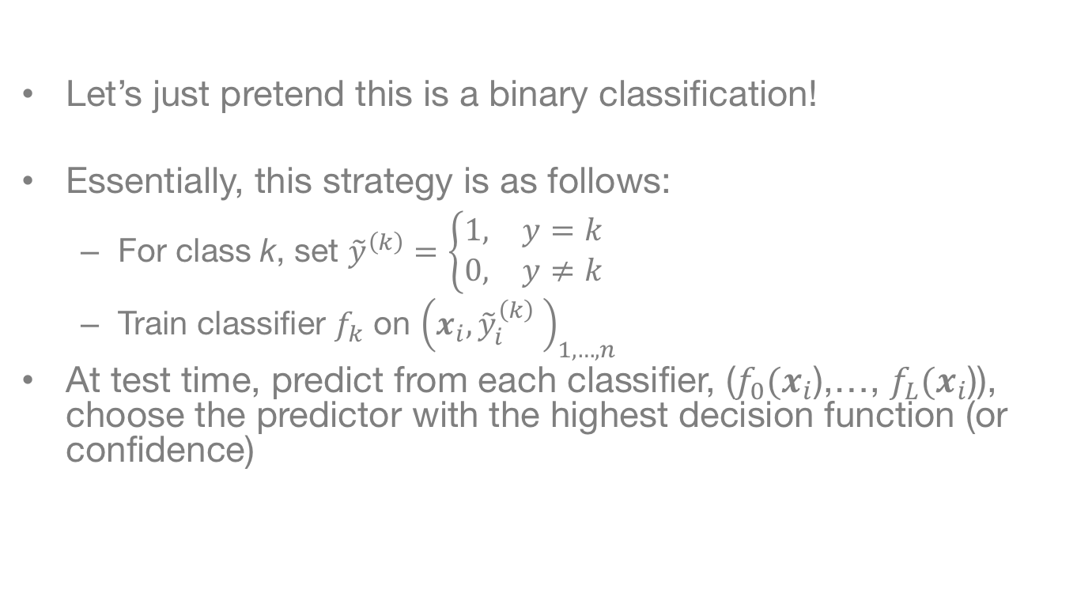
One-vs-Rest Classification
Let’s just pretend this is a binary classification!
Essentially, this strategy is as follows:
For class k, set ${\tilde{y}}^{\left(k\right)}=\left\{\begin{aligned}\begin{matrix}1, & y=k\end{matrix} \\ \begin{matrix}0, & y≠k\end{matrix}\end{aligned}\right.$
Train classifier $f_{k}$ on ${\left(x_{i},{\tilde{y}}_{i}^{\left(k\right)} \right)}_{1,…,n}$
At test time, predict from each classifier, ($f_{0}(x_{i}$),…, $f_{L}(x_{i}$)), choose the predictor with the highest decision function (or confidence)

Slide 18
One-versus-Rest Logistic Regression

Slide 19
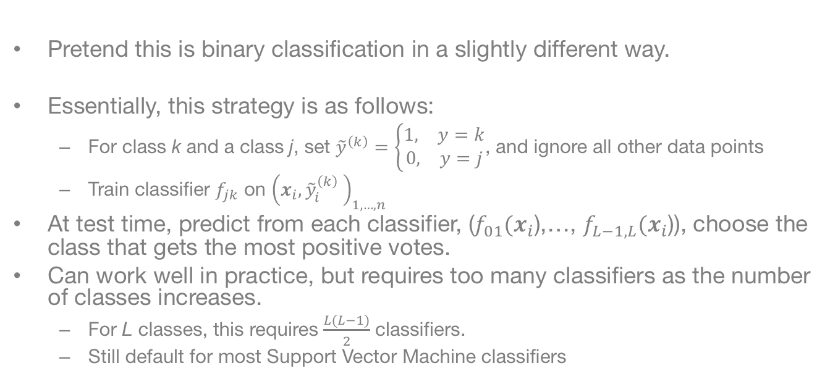
One-vs-One Classification
Pretend this is binary classification in a slightly different way.
Essentially, this strategy is as follows:
For class k and a class j, set ${\tilde{y}}^{\left(k\right)}=\left\{\begin{aligned}\begin{matrix}1, & y=k\end{matrix} \\ \begin{matrix}0, & y=j\end{matrix}\end{aligned}\right.$, and ignore all other data points
Train classifier $f_{jk}$ on ${\left(x_{i},{\tilde{y}}_{i}^{\left(k\right)} \right)}_{1,…,n}$
At test time, predict from each classifier, ($f_{01}(x_{i}$),…, $f_{L−1,L}(x_{i}$)), choose the class that gets the most positive votes.
Can work well in practice, but requires too many classifiers as the number of classes increases.
For L classes, this requires $\frac{L(L−1)}{2}$ classifiers.
Still default for most Support Vector Machine classifiers

Slide 20
Multi-Class Performance EValuation

Slide 21
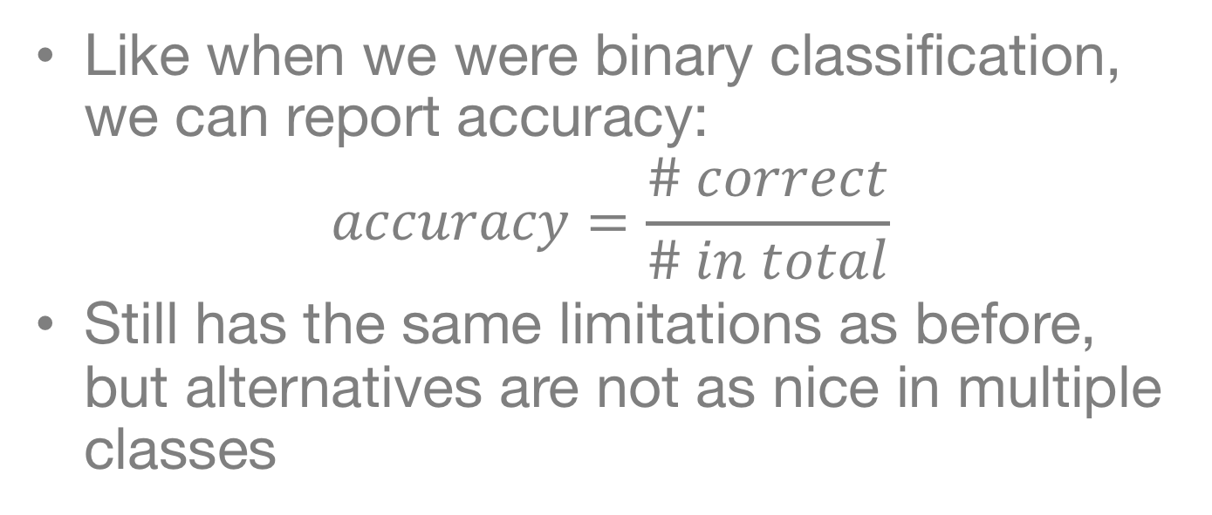
Accuracy
Like when we were binary classification, we can report accuracy:
$$accuracy=\frac{\# correct}{\# in total}$$
Still has the same limitations as before, but alternatives are not as nice in multiple classes

Slide 22
Confusion Matrix
Confusion matricies aren’t limited to binary classification problems. They can also be used to visualize what’s happening in multiple classification problems.
This is the confusion matrix on MNIST for softmax (multiclass logistic) regression

Slide 23
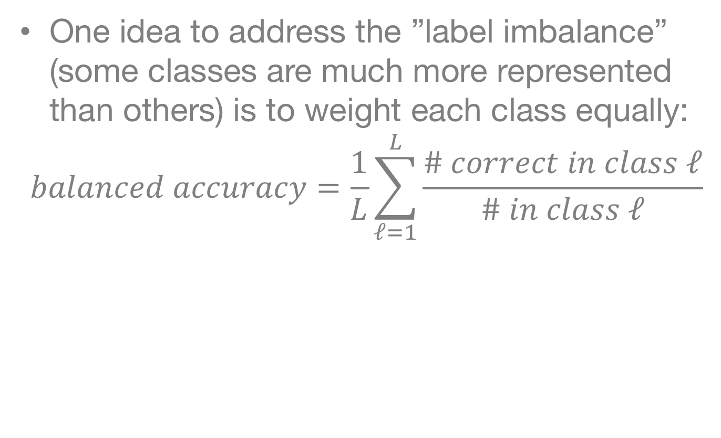
Balanced Accuracy
One idea to address the ”label imbalance” (some classes are much more represented than others) is to weight each class equally:
$$balanced accuracy=\frac{1}{L}\sum_{ℓ=1}^{L}{\frac{\# correct in class ℓ}{\# in class ℓ}}$$

Slide 24
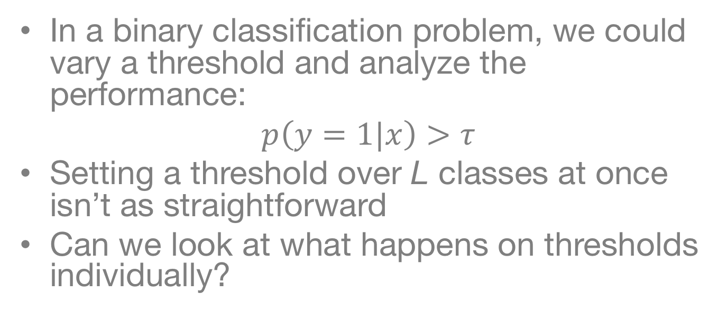
Setting a Threshold?
In a binary classification problem, we could vary a threshold and analyze the performance:
$$p\left(y=1|x\right)>τ$$
Setting a threshold over L classes at once isn’t as straightforward
Can we look at what happens on thresholds individually?

Slide 25
The ROC Curve
We could look at ROCs and AUCs for each class and average over them.
Here, we can turn each situation into a binary example problem (class j versus all over classes).
This is typically not done for two reasons:
Historical preferences
When you get lots of classes, way fewer true positives than potential false positives, turns into an “information retrieval” problem

Slide 26
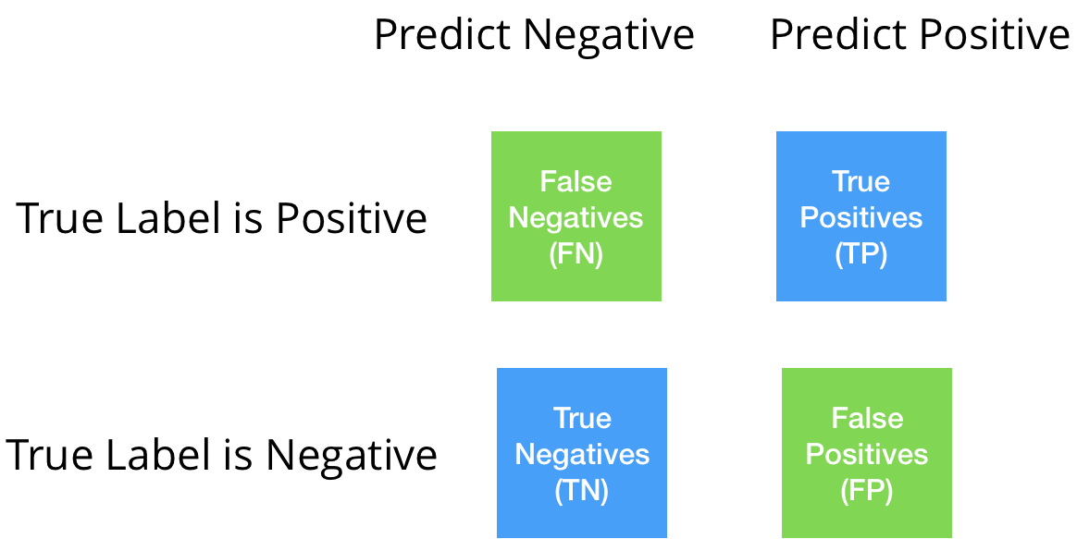
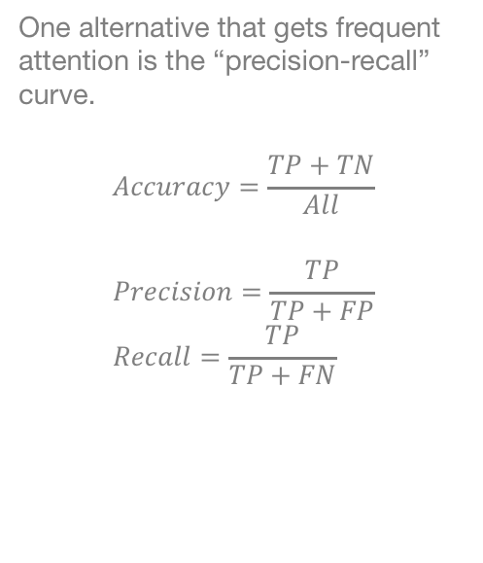
Precision-Recall
One alternative that gets frequent attention is the “precision-recall” curve.
$$Accuracy=\frac{TP+TN}{All}$$
$$Precision=\frac{TP}{TP+FP} \\ Recall=\frac{TP}{TP+FN}$$

Slide 27
Precision-Recall can also be shown as a curve
We can visualized what would happen as we vary the threshold on a single class.
Like in the ROC curve, we can get the Area Under the Curve.
This is typically called “Average Precision”
Sometimes called Area Under the Precision Recall Curve (AUPRC)
This is the precision-recall curve for the number 5.

Slide 28
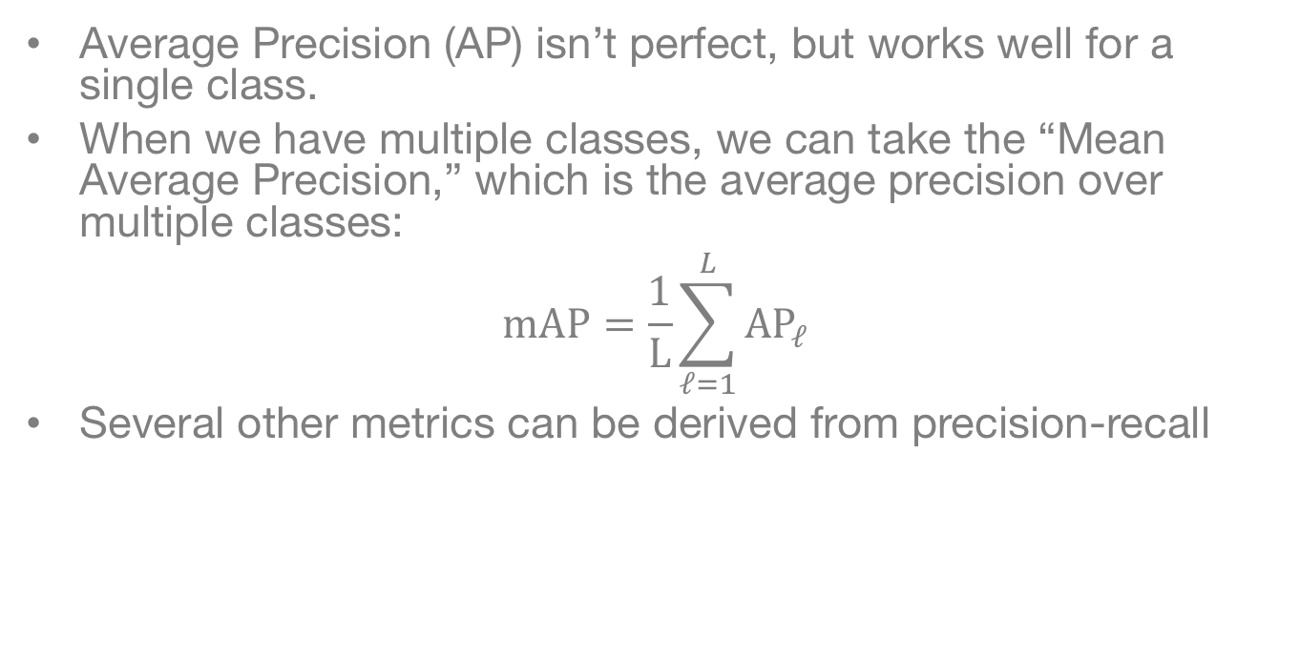
Mean Average Precision
Average Precision (AP) isn’t perfect, but works well for a single class.
When we have multiple classes, we can take the “Mean Average Precision,” which is the average precision over multiple classes:
$$mAP=\frac{1}{L}\sum_{ℓ=1}^{L}{AP_{ℓ}}$$
Several other metrics can be derived from precision-recall

Slide 29
Conclusions
Multi-class requires extended the models we’ve seen so far
Both model specific (i.e. softmax) and general (i.e one-vs-all) techniques
Requires some modifications to thinking about performance evaluation
(Balanced) Accuracy is by far the most common metric in scientific applications
Confusion matrices can be very helping
Most current machine learning benchmarks use mean Average Precision or a related metric

